Slide 1
THE NEW AIR FORCE VIRTUAL EDUCATION CENTER (AFVEC) STUDENT TUTORIAL
Heather Hagen
720-847-
heather.hagen.3@us.af.mil

Slide 2
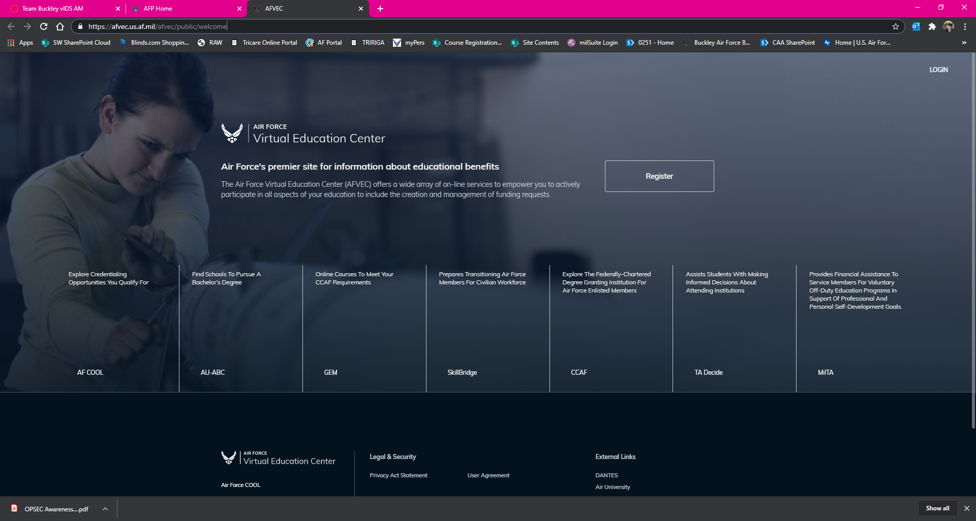
ALWAYS USE CHROME OR EDGE AS YOUR BROWSER TO SUCCESSFULLY ACCESS AFVEC!
START HERE TO LOGIN

Slide 3
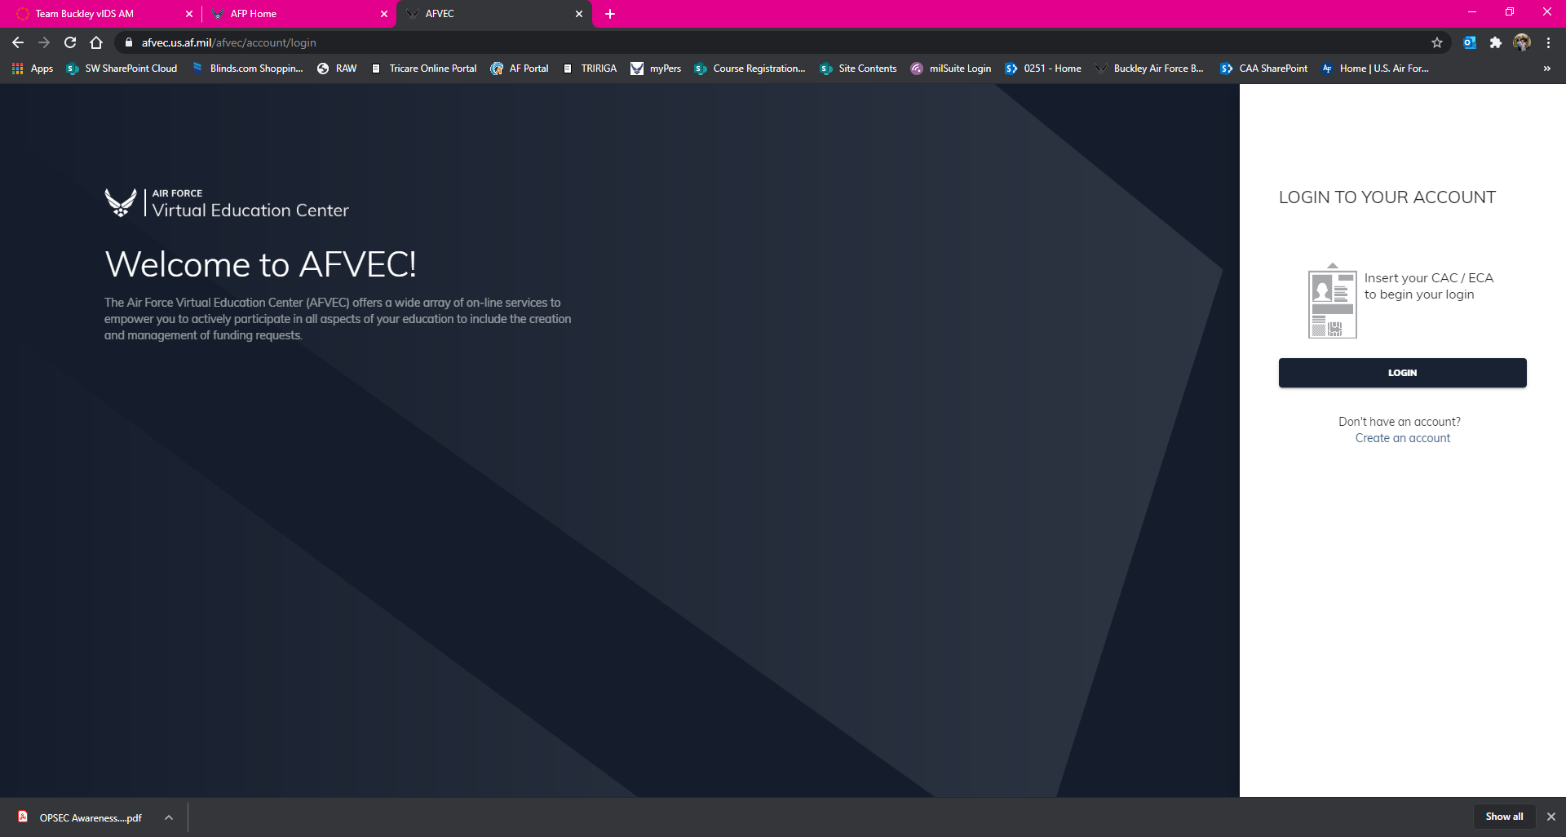
START HERE TO LOGIN – ENSURE YOU SELECT THE CORRECT CERTIFICATE!

Slide 4
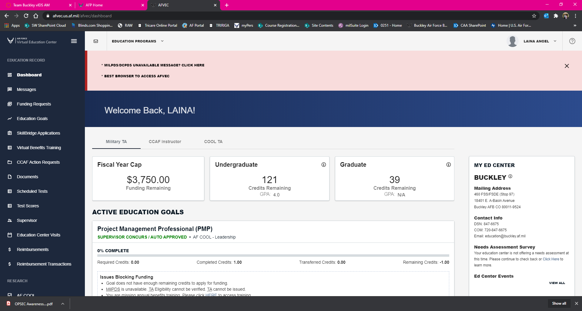
DASHBOARD VIEW – AFVEC DEFAULTS TO THIS VIEW UPON LOGGING IN

Slide 5
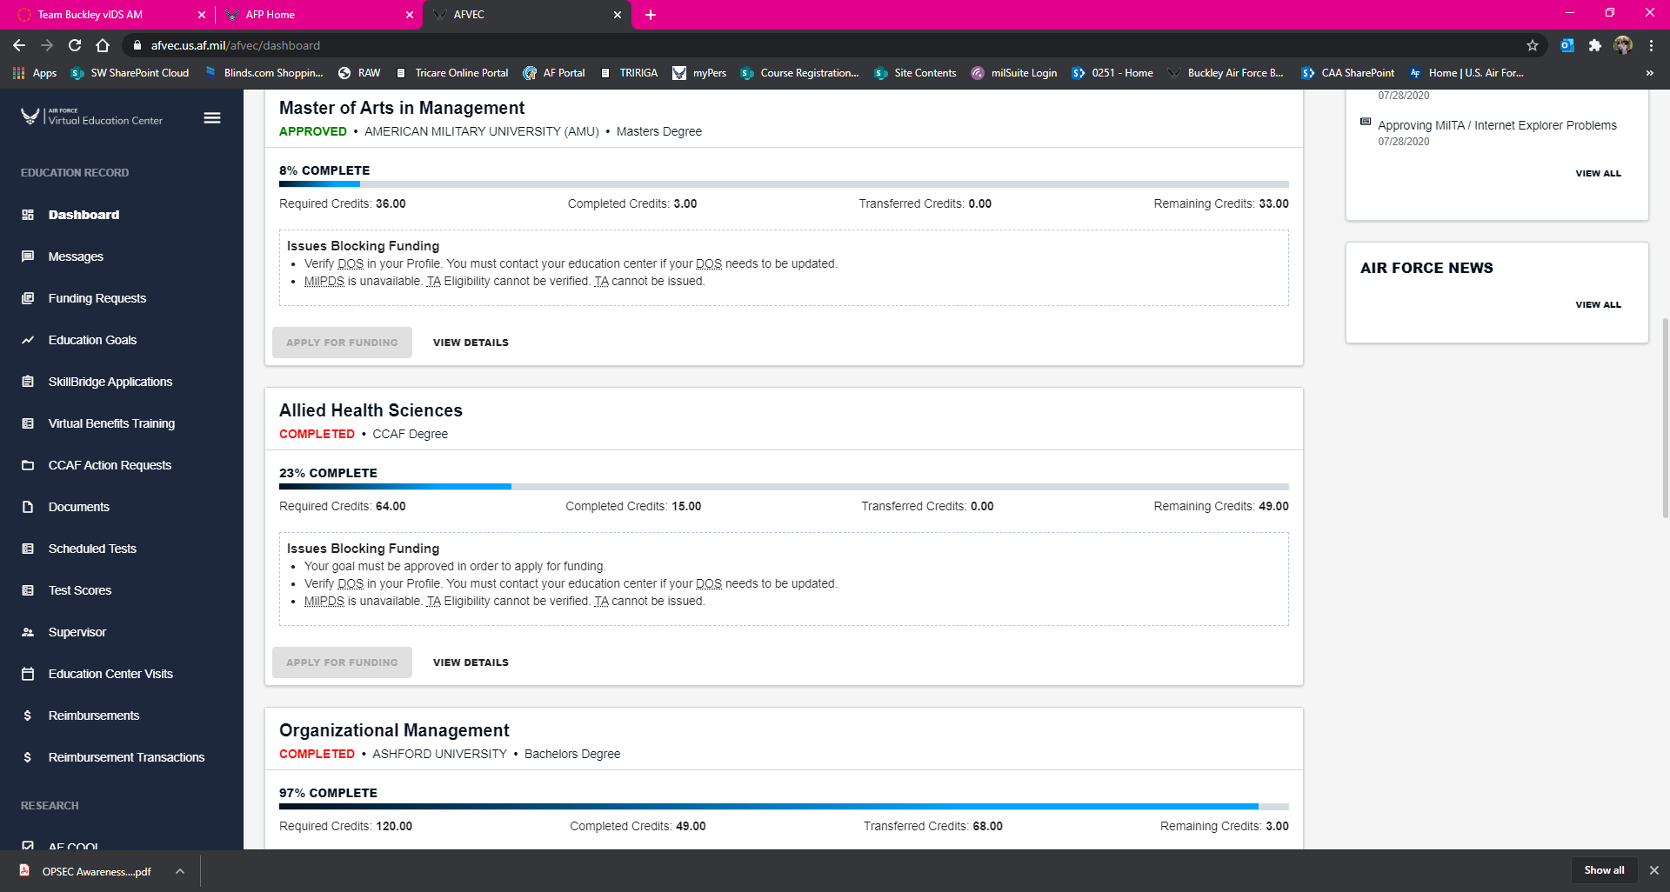
DASHBOARD VIEW CONT’D
QUICK BUTTONS ON THE LEFT TO NAVIGATE TO OTHER SECTIONS WITHIN AFVEC

Slide 6
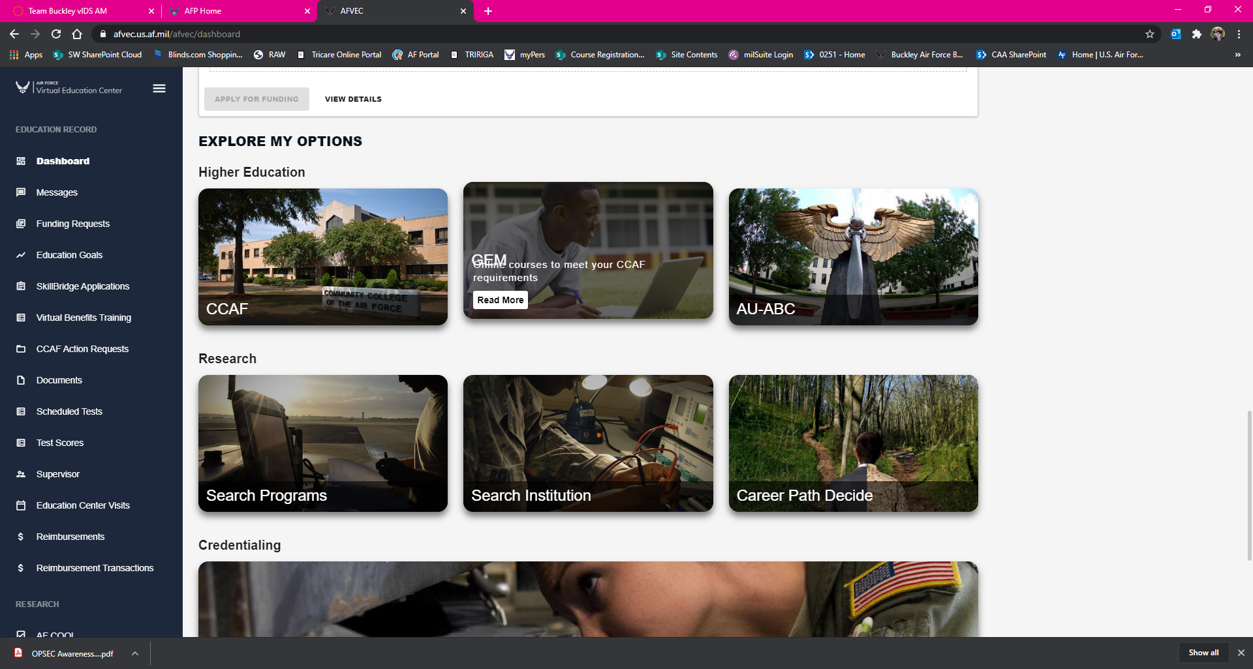
IF YOU SCROLL DOWN FROM THE INITIAL DASHBOARD PAGE, YOU WILL FIND QUICK LINKS AT THE BOTTOM FOR THE MORE COMMONLY USED SECTIONS

Slide 7
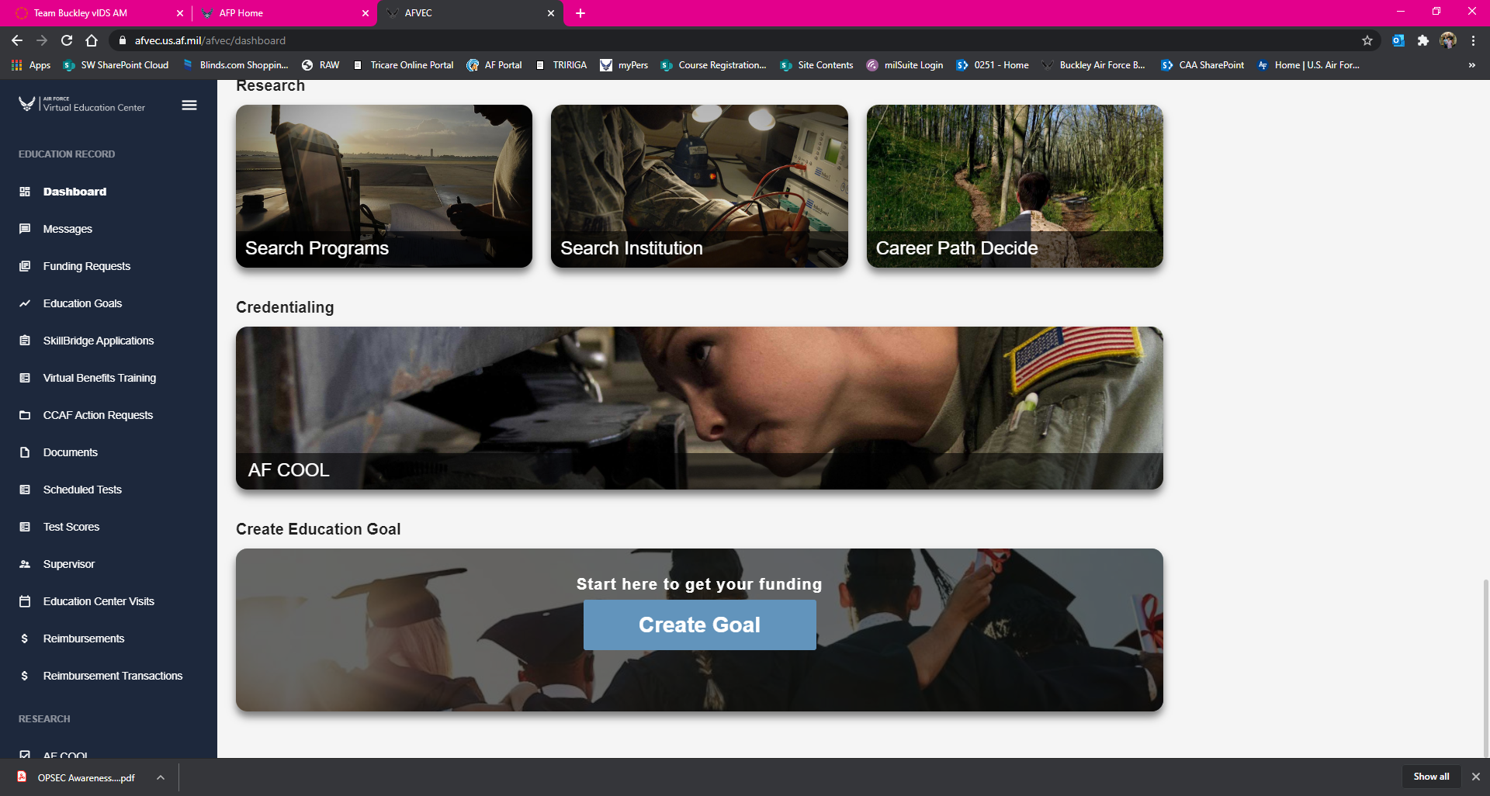
THESE QUICK LINKS ALSO INCLUDE A “CREATE EDUCATION GOAL” BUTTON FOR AN EASY START

Slide 8
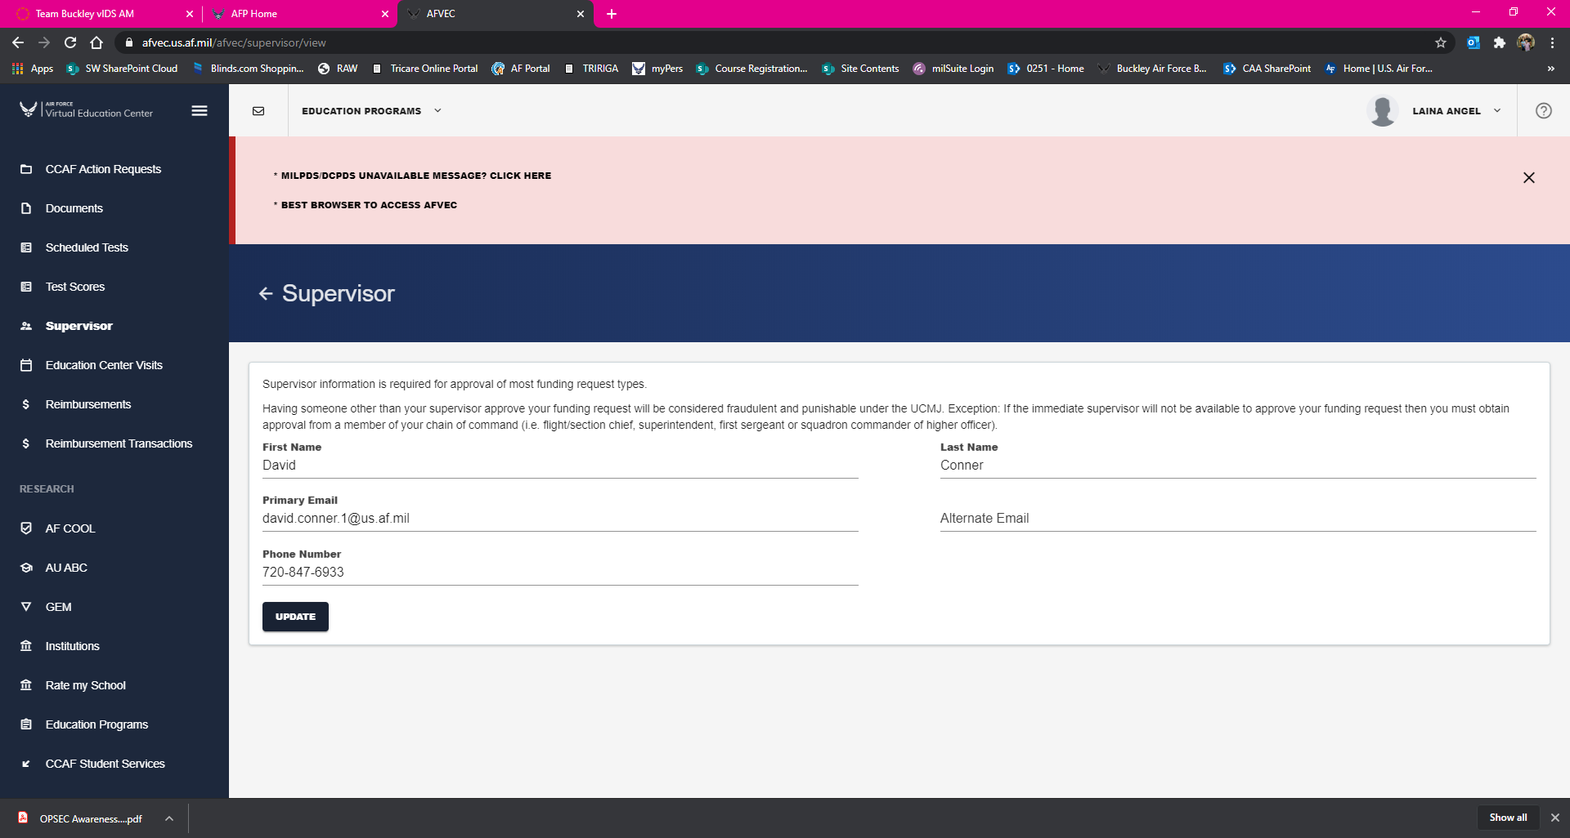
FOR THOSE THAT NEED TO UPDATE YOUR SUPERVISOR INFORMATION, THIS IS WHAT IT LOOKS LIKE. ONCE YOU HAVE UPDATED THE INFO, SELECT “UPDATE” AT THE BOTTOM

Slide 9
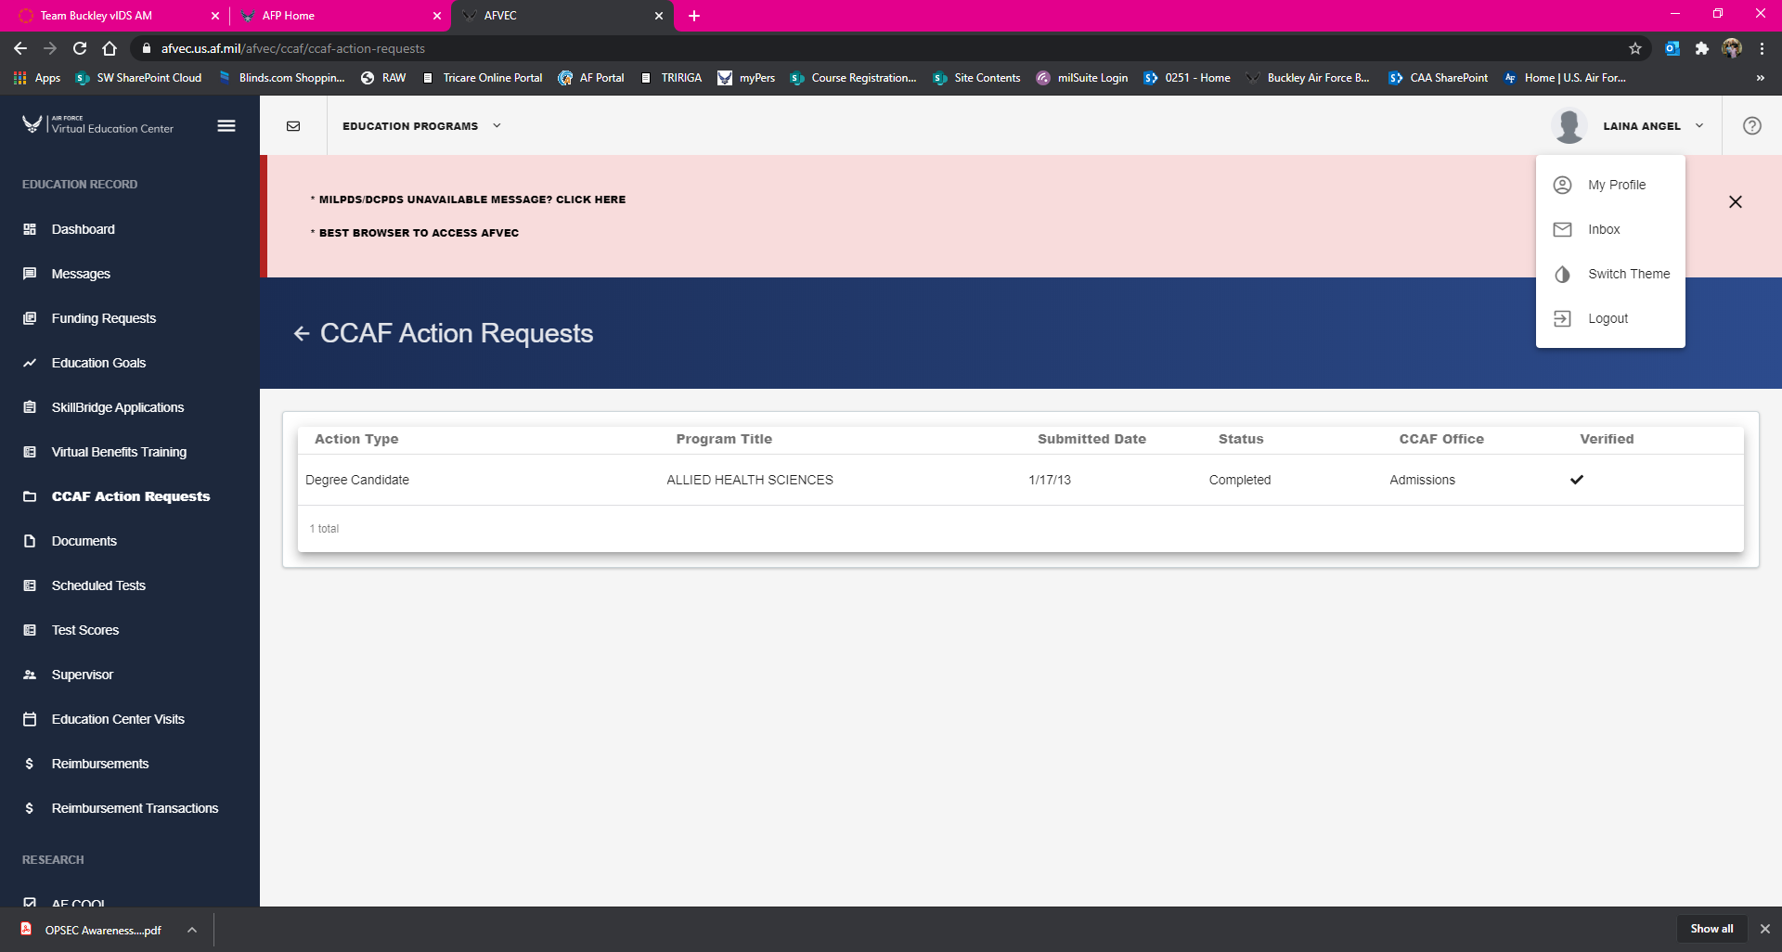
FOR THOSE THAT NEED TO UPDATE YOUR PROFILE INFORMATION, SELECT YOUR NAME/ICON AT THE UPPER RIGHT OF THE SCREEN, AND SELECT “MY PROFILE”

Slide 10
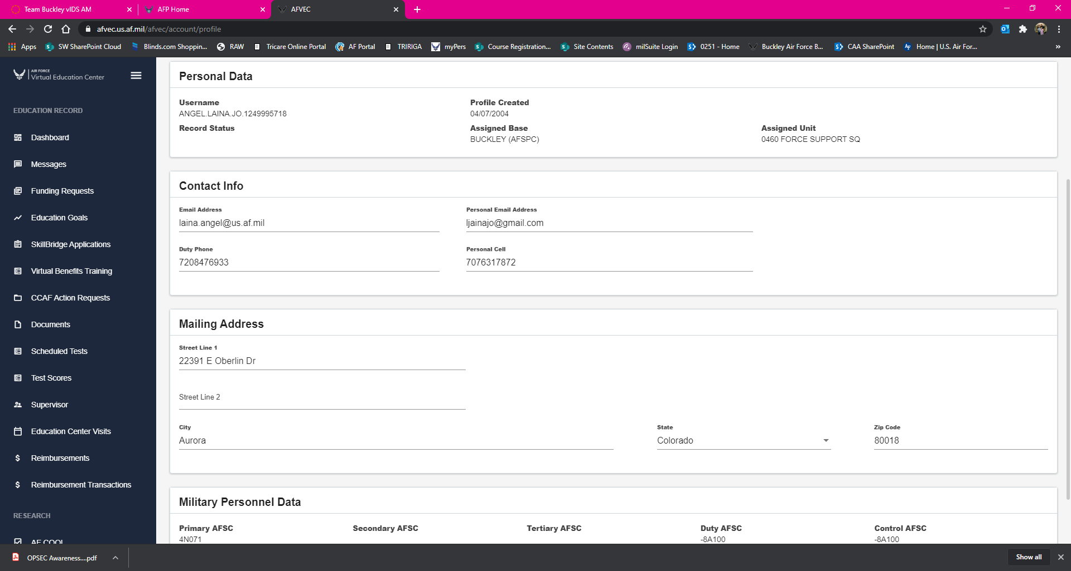
NO LINES
YOUR EDITABLE INFORMATION WILL HAVE A LINE UNDERNEATH. IF THERE IS NOT A LINE, BUT THE INFORMATION IS INCORRECT, YOU NEED TO CONTACT THE EDUCATION OFFICE FOR GUIDANCE.
LINES = CAN EDIT

Slide 11
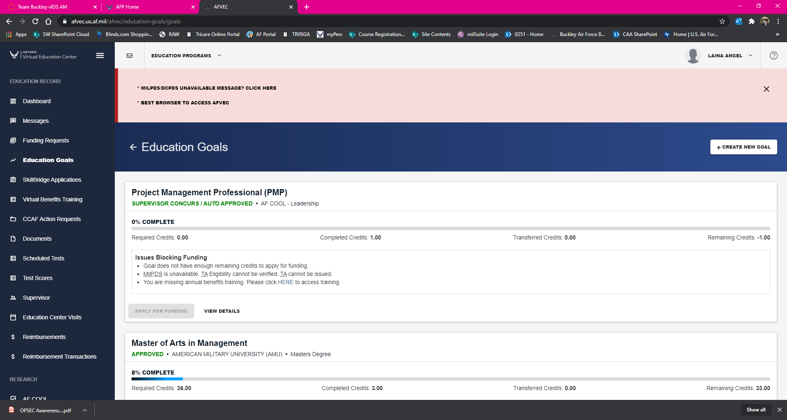
FOR THOSE THAT WANT TO SEE THE STATUS OF ALREADY-ESTABLISHED EDUCATION GOALS, THIS IS WHAT IT LOOKS LIKE. YOU CAN ALSO CREATE A NEW EDUCATION GOAL FROM THIS SCREEN.

Slide 12
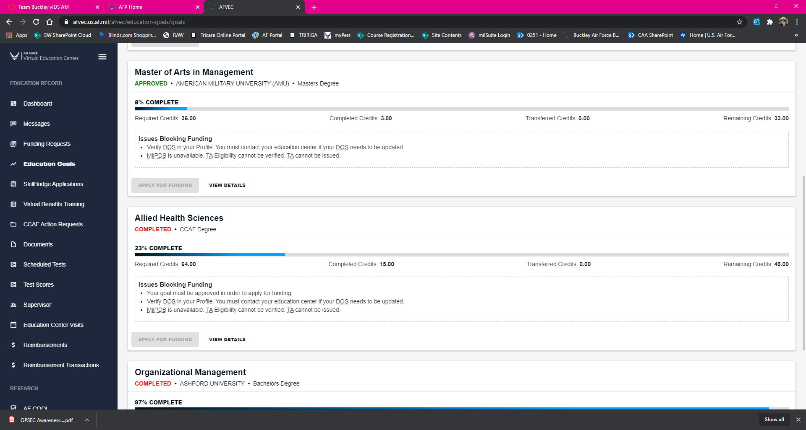
HERE IS AN OPEN “APPROVED” GOAL
IF YOU SEE GOALS THAT DO NOW SHOW A COMPLETE LINE, PAY ATTENTION TO THE ACTUAL STATUS AT THE TOP. IF THEY SAY THEY ARE “COMPLETED”, THEY ARE ALREADY COMPLETED AND FILED – THE % COMPLETE DOES NOT MATTER.

Slide 13
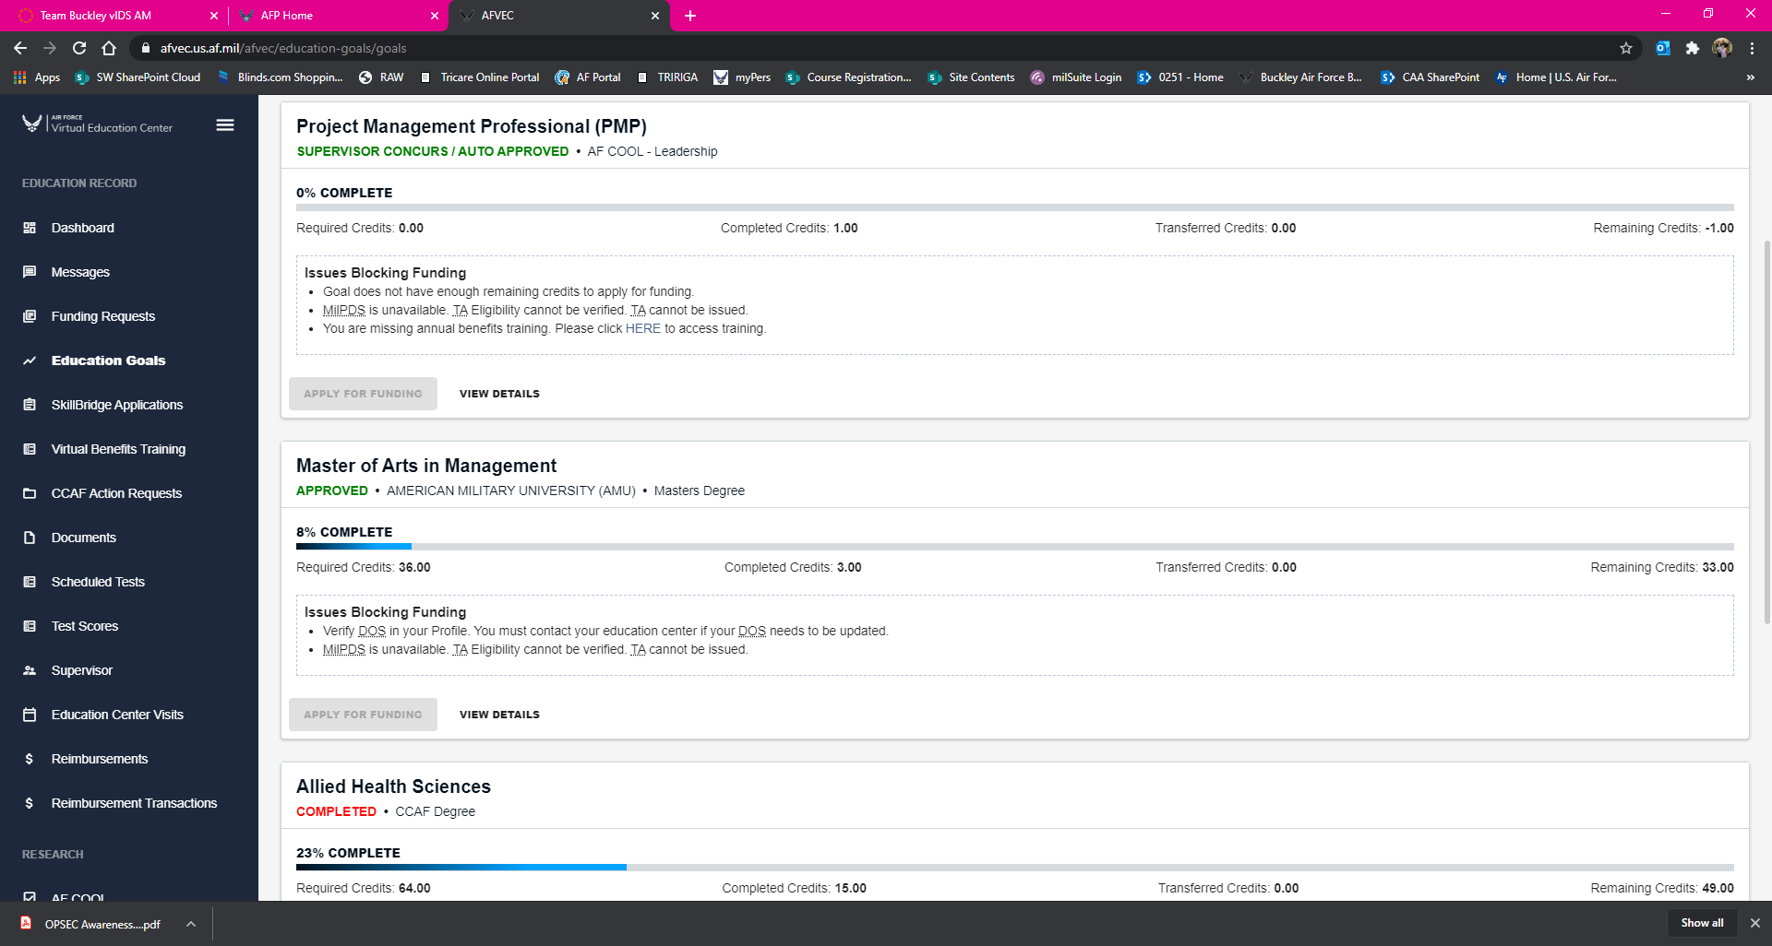
IF YOU ARE TRYING TO APPLY FOR FUNDING (APPLY FOR TA) FROM HERE, AND YOU NOTICE THE BUTTON IS GREYED OUT, YOU NEED TO READ THE “ISSUES BLOCKING FUNDING” SECTION. IF THESE ARE ITEMS YOU CANNOT FIX, PLEASE CONTACT THE EDUCATION OFFICE FOR ASSISTANCE.

Slide 14

IF ONE OF THE MESSAGES WAS “YOU ARE MISSING ANNUAL BENEFITS TRAINING”, YOU CAN SELECT THIS TO GET TO IT EASILY.

Slide 15
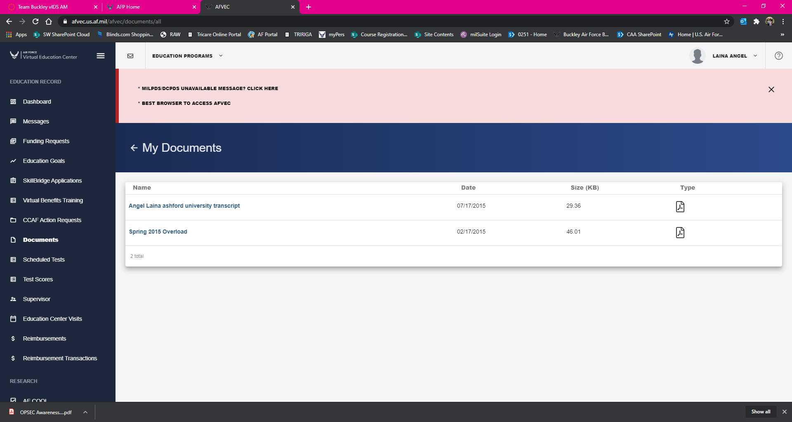
IF YOU NEED TO CONFIRM THAT DOCUMENTS WERE UPLOADED SUCCESSFULLY BY THE EDUCATION OFFICE, SELECT “DOCUMENTS” AND THIS IS WHAT IT LOOKS LIKE

Slide 16
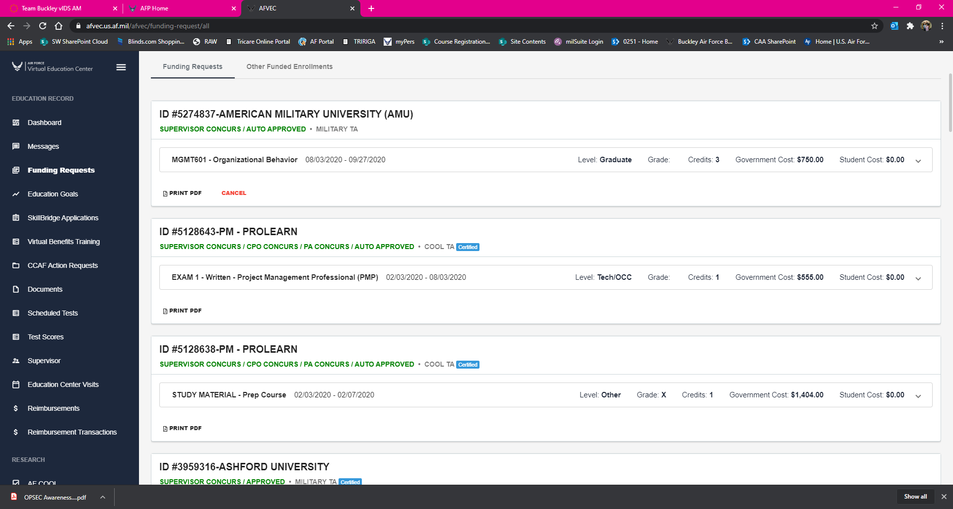
IF YOU NEED TO CHECK ON THE STATUS OF YOUR ALREADY-SUBMITTED FUNDING (TA) REQUESTS, SELECT “FUNDING REQUESTS” AND THIS IS WHAT IT LOOKS LIKE
NOTICE THE SUPERVISOR CONCURS STATUS UNDER THE REQUEST ID

Slide 17
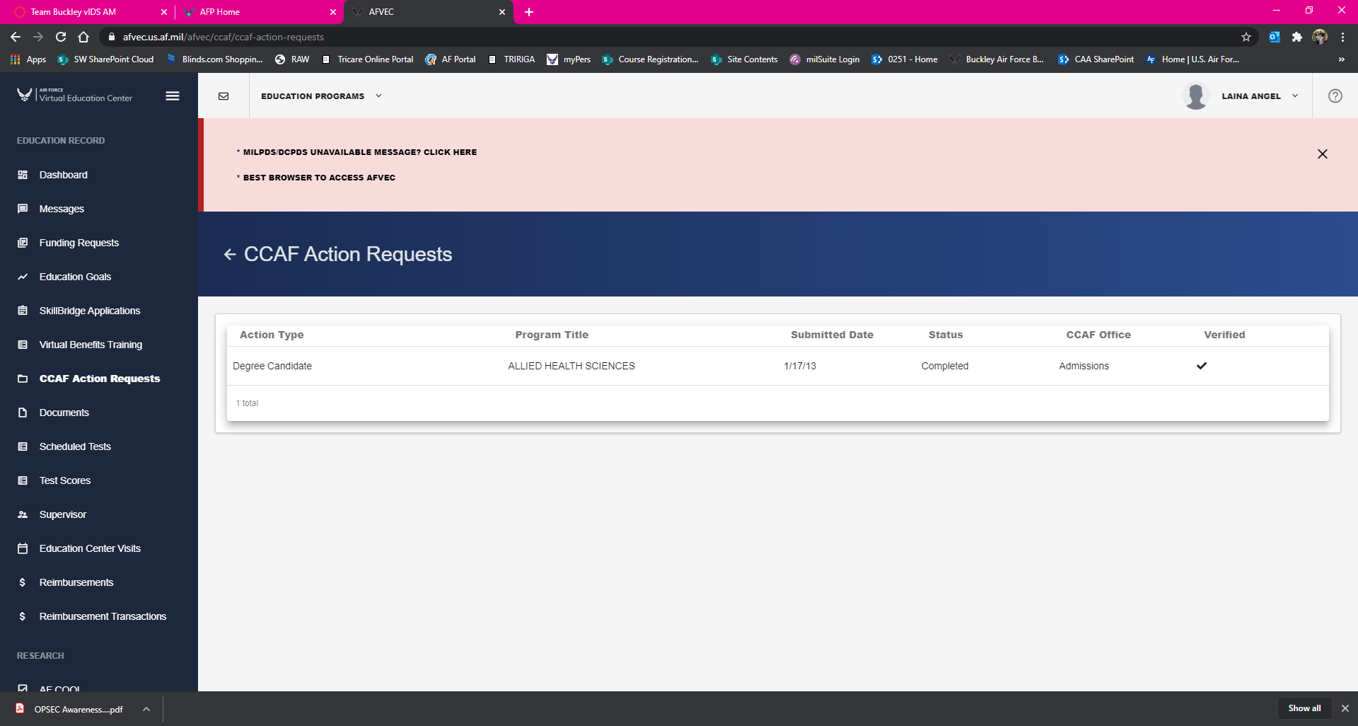
IF YOU NEED TO CHECK ON THE STATUS OF YOUR CCAF, OR HAVE SUBMITTED ACTION REQUESTS FOR YOU CCAF, SELECT “CCAF ACTION REQUESTS” AND THIS IS WHAT YOU SEE
IF YOU HAVE COMPLETED YOUR CCAF, AND THE CHECK MARK UNDER VERIFIED IS PRESENT, YOUR CCAF HAS ALREADY BEEN VETTED THROUGH THE EDUCATION OFFICE AND IS ON FILE

Slide 18
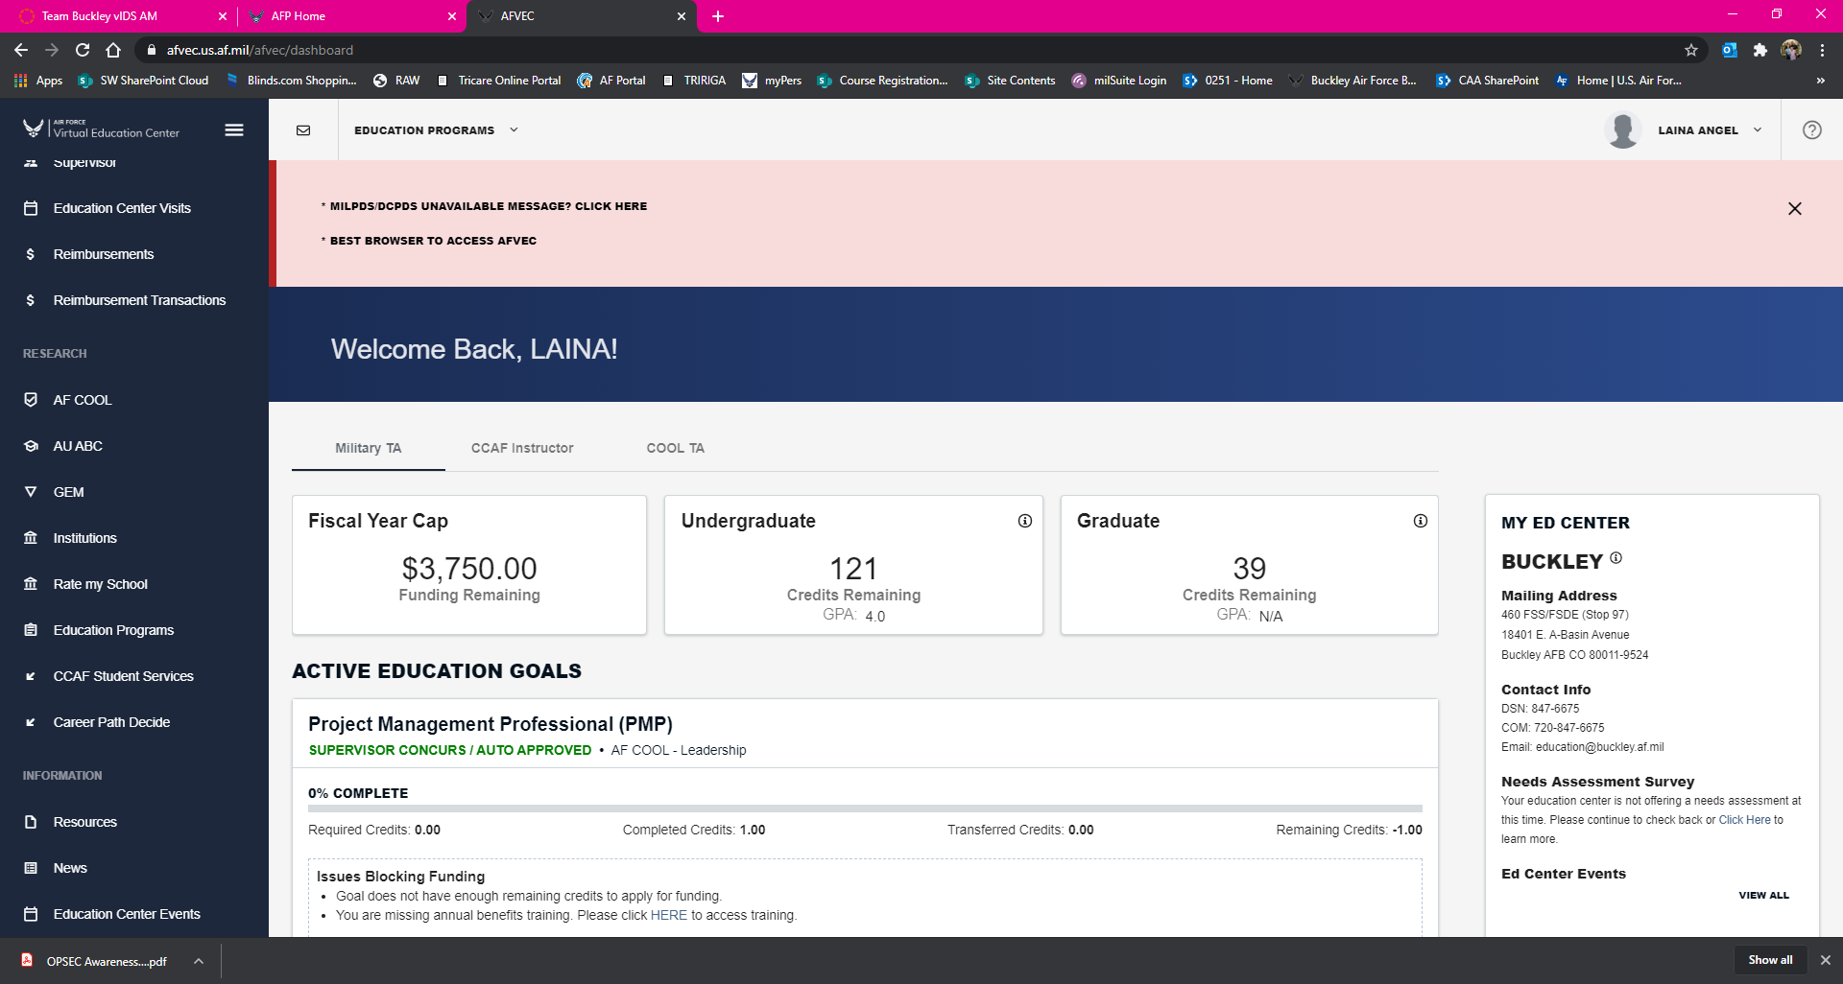
IF YOU NEED CCAF STUDENT SERVICES, INFORMATION ON AFCOOL, THE AUABC PROGRAM, ETC. SCROLL DOWN TO THE BOTTOM OF THE QUICK LINKS ON THE LEFT AND YOU WILL FIND THEM UNDER THE RESEARCH HEADING

Slide 19
QUESTIONS?
Contact Education by phone at
720-847-6755
Or via email at
460.FSS.FSD.Education.Office@us.af.mil

